Slide 1
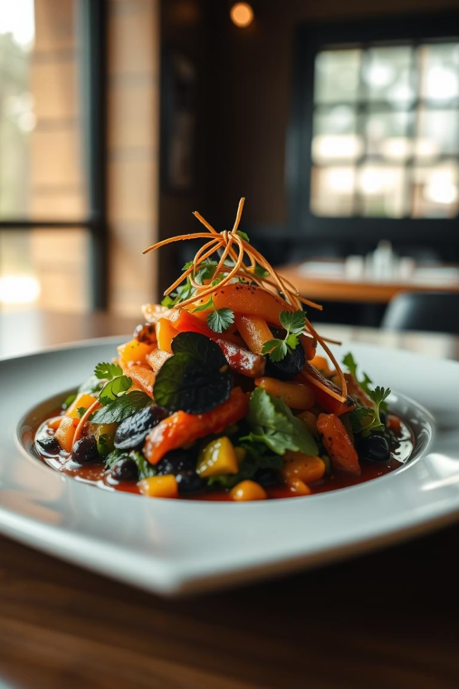

YourHungry AI: Solving The “What To Eat” Dilemma
A web application that combines AI-powered recipe generation with geolocation-based restaurant discovery to solve the "what to eat" dilemma.
by Rohan Murugan

Slide 2
Problem: Food Indecision
Decision Fatigue
Lack of Centralized Solutions
Many people struggle with making decisions about what to cook or eat.
There is no single platform that combines recipe generation with restaurant search.

Slide 3




Target Audience
Home Cooks
Food Enthusiasts
Those who enjoy cooking at home but need inspiration and guidance.
Individuals passionate about exploring new cuisines and recipes.
Busy Professionals
Those who have limited time and need quick meal solutions.

Slide 4

Project Inspiration
Personal Experience
Market Gap
Alignment with Trends
Fueled by personal frustration with meal indecision.
Recognized the need for a comprehensive food discovery platform.
Leverages cutting-edge AI, web development, and geolocation technologies.

Slide 5
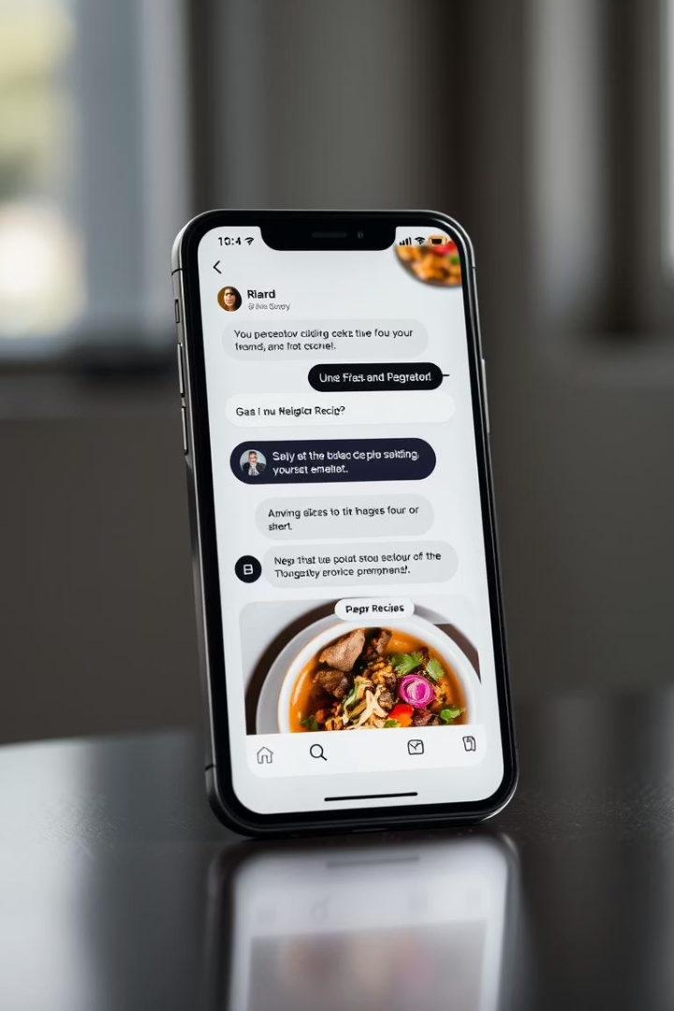



Solution Overview
Natural Language Input
Users provide dish requests in plain English.
AI-Powered Recipe Generation
OpenAI generates detailed and visually appealing recipes.
Geolocation-Based Restaurant Search
Discover nearby restaurants serving the desired dish.

Slide 6
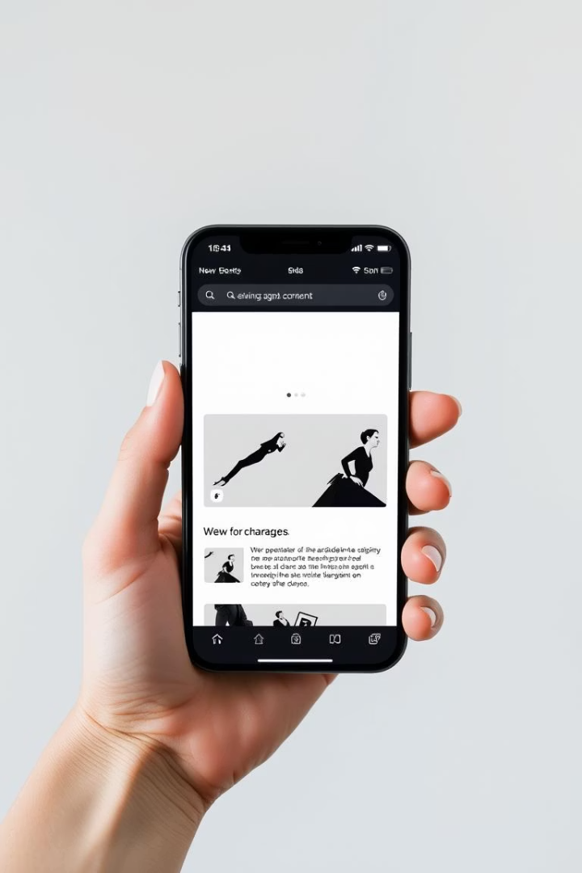



Key Considerations
User-centric design for an intuitive experience.
Secure data handling and privacy protection.
Accessibility through OAuth login with popular platforms.

Slide 7


Data Acquisition
Dynamic Recipe Generation
1
Utilizes OpenAI for real-time recipe creation.
Real-time Restaurant Search
2
Leverages Google Places API for location-based recommendations.

Slide 8




Technological Stack
Backend
Node.js, Express, MongoDB Atlas.
Frontend
React, Tailwind CSS.
AI Integration
OpenAI GPT-3.5 for recipe generation.

Slide 9
Addressing Concerns
API Key Security
1
Implemented environment variables and server-side routing.
Cost Optimization
2
Leveraged free tiers for AI and location services.
User Privacy
3
Ensured explicit consent for location data usage.

Slide 10
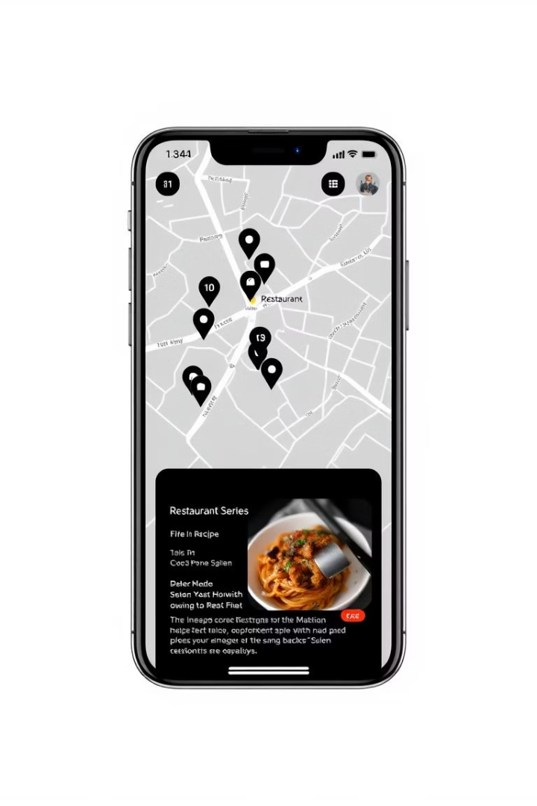
Data Visualization
1
2
Markdown Formatting
Interactive Maps
Enhances recipe readability and visual appeal.
Future integration of Google Maps for restaurant visualization.
3
Tag-Based Filters
Planned feature for personalized search based on cuisines or ingredients.

Slide 11
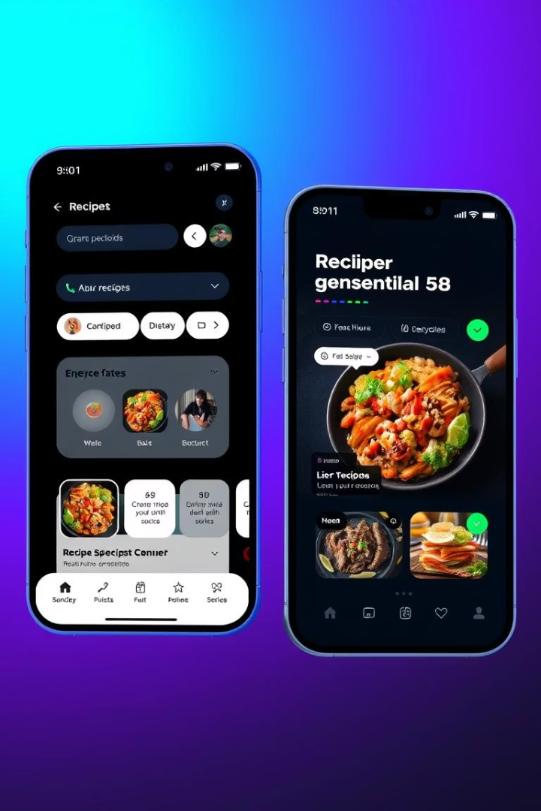
What Sets YourHungry AI Apart?
Dual Functionality
Combines recipe generation and restaurant recommendations seamlessly.
Personalized Experience
Markdown-based, image-rich, and interactive AI-powered user interface.

Slide 12
Why Choose YourHungry AI Over Competitors?
All-in-One Platform
Food inspiration and real dining recommendations in one place.
Ad-Free Environment
No spam or intrusive advertisements to disrupt the experience.
AI Personal Assistant
Feel the tailored support with an intelligent assistant.
Modern UX
Clean, sleek interface enhancing usability and engagement.

Slide 13
Challenges in Scaling YourHungry AI
Cost Management
Infrastructure Load
Content Moderation
Personalization Complexity
API expenses rise with growing user base.
Scaling server and database to handle traffic efficiently.
Ongoing efforts to filter unsafe or irrelevant data.
Manage multi-language and diet preferences at scale.

Slide 14





Recommendations for Implementation Team
Use Serverless Setup
Adopt Vercel and MongoDB Atlas for reliable infrastructure.
Monitor API Usage
Set up alerts to control OpenAI and Google API consumption.
Optimize Requests
Prioritize caching and batching calls to reduce costs.
Test Security
Regularly validate CORS and authentication across environments.

Slide 15
Data Protection Strategy
Token Safety
User Privacy
Secure Storage
Moved token management from frontend to backend middleware.
Location access requested explicitly, used only on demand.
JWT tokens stored safely with expiry managed carefully.

Slide 16

Market Forecast for YourHungry AI
Early Adoption
Targeting bloggers, food communities, and students first.
Promotional Tactics
Leverage Discord marketing and recipe-sharing features.
Expansion Potential
Grow into a global culinary recommendation platform.

Slide 17

Thank You!
We appreciate your interest in YourHungry AI. We're excited to bring our innovative food recommendation platform to life.
We're committed to providing a personalized and enjoyable experience for all users. We'll continue to develop and refine YourHungry AI based on your valuable feedback.

